Slide 1
Great Hall Directory
Cristo Coyote, Julius Abaane Nsorh, and Michelle Santamaria

Slide 2
The Problem
Loading…
Client: Mrs. Seals from the Office of Undergraduate Admissions
Students get lost in the Great Hall often and have to ask around to find their classes.

Slide 3
Our solution
Create a program that acts as a directory where students can enter the room they want to find. This program returns directions to the room. Also this program is hosted on a website that can be reached via QR code.

Slide 4
Limitations
Because of the way we implemented the code, pictures can not be displayed in the program. To circumvent this issue, we plan to put up pictures of maps of each floor on their respective floor.
We also made a static HTML site that does display maps as an alternative. This site would also be reached via QR code
The Great Hall is the one place on campus where you cannot put up posters. We are currently working with Monmouth University Staff to see if an exception can be made since this is meant to help everyone.

Slide 5

Reflection :
Through this project, we learned how real world problems like students getting lost in the Great Hall can be solved using Technology.
Collaborating as a team helped us improve communication, divide tasks effectively, and combine our strengths to build a solution we’re proud of.

Slide 6
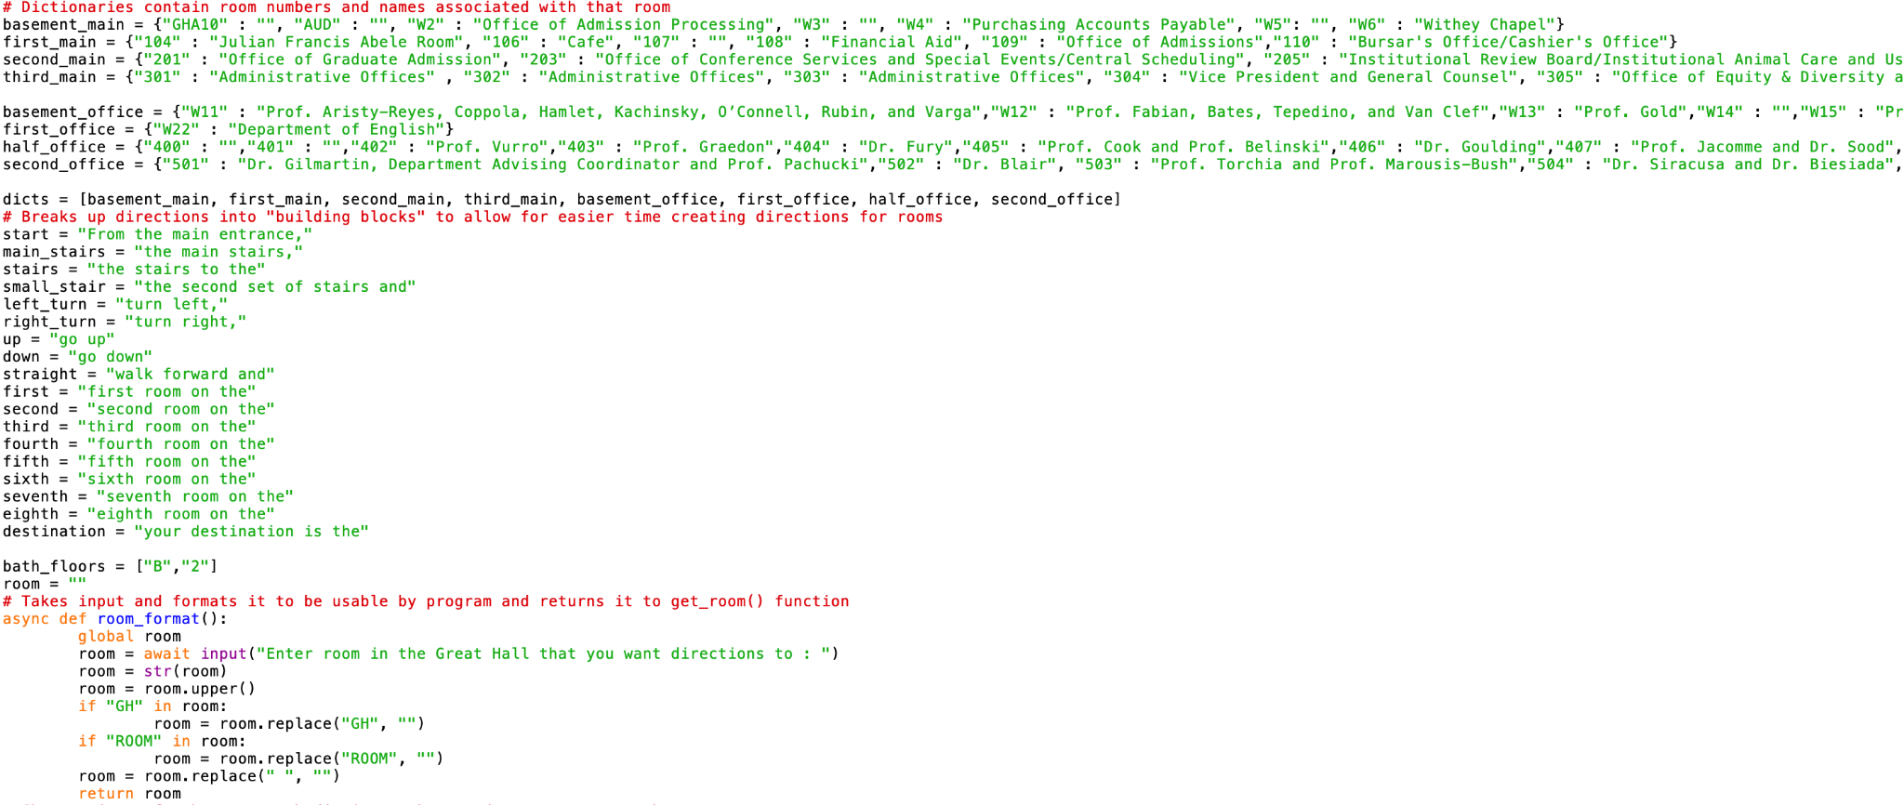

Slide 7
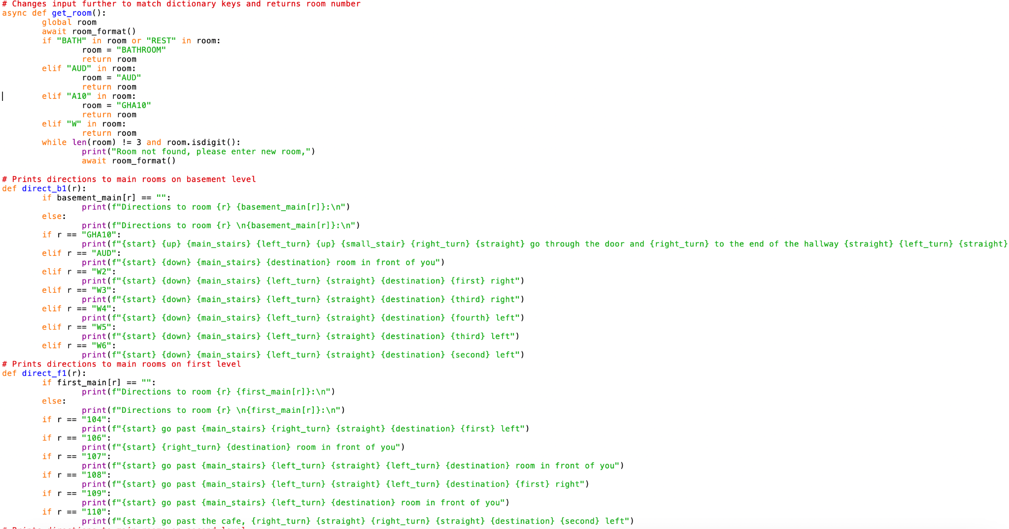

Slide 8
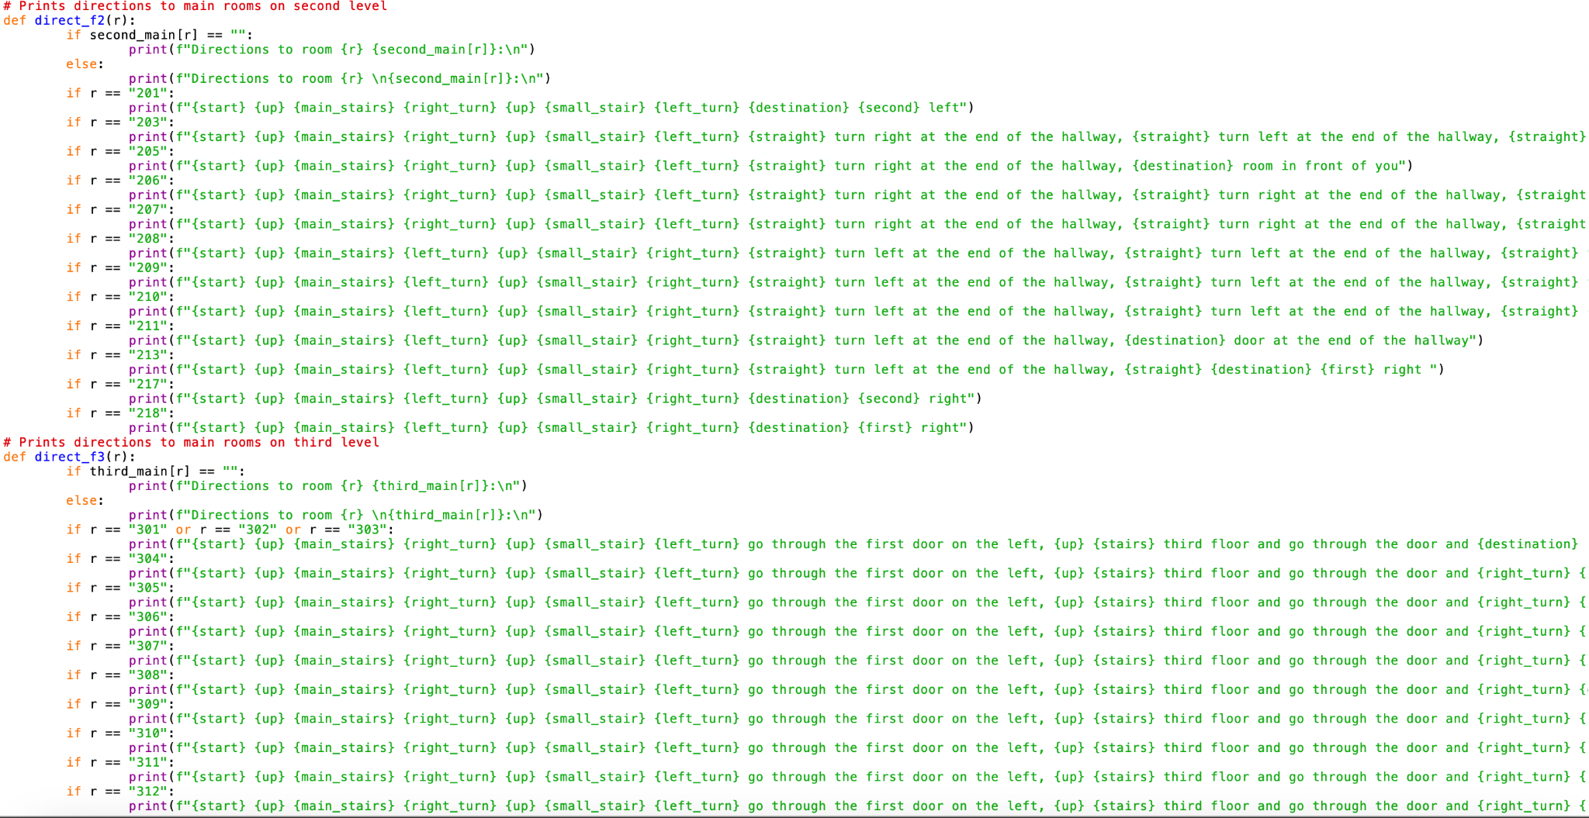

Slide 9
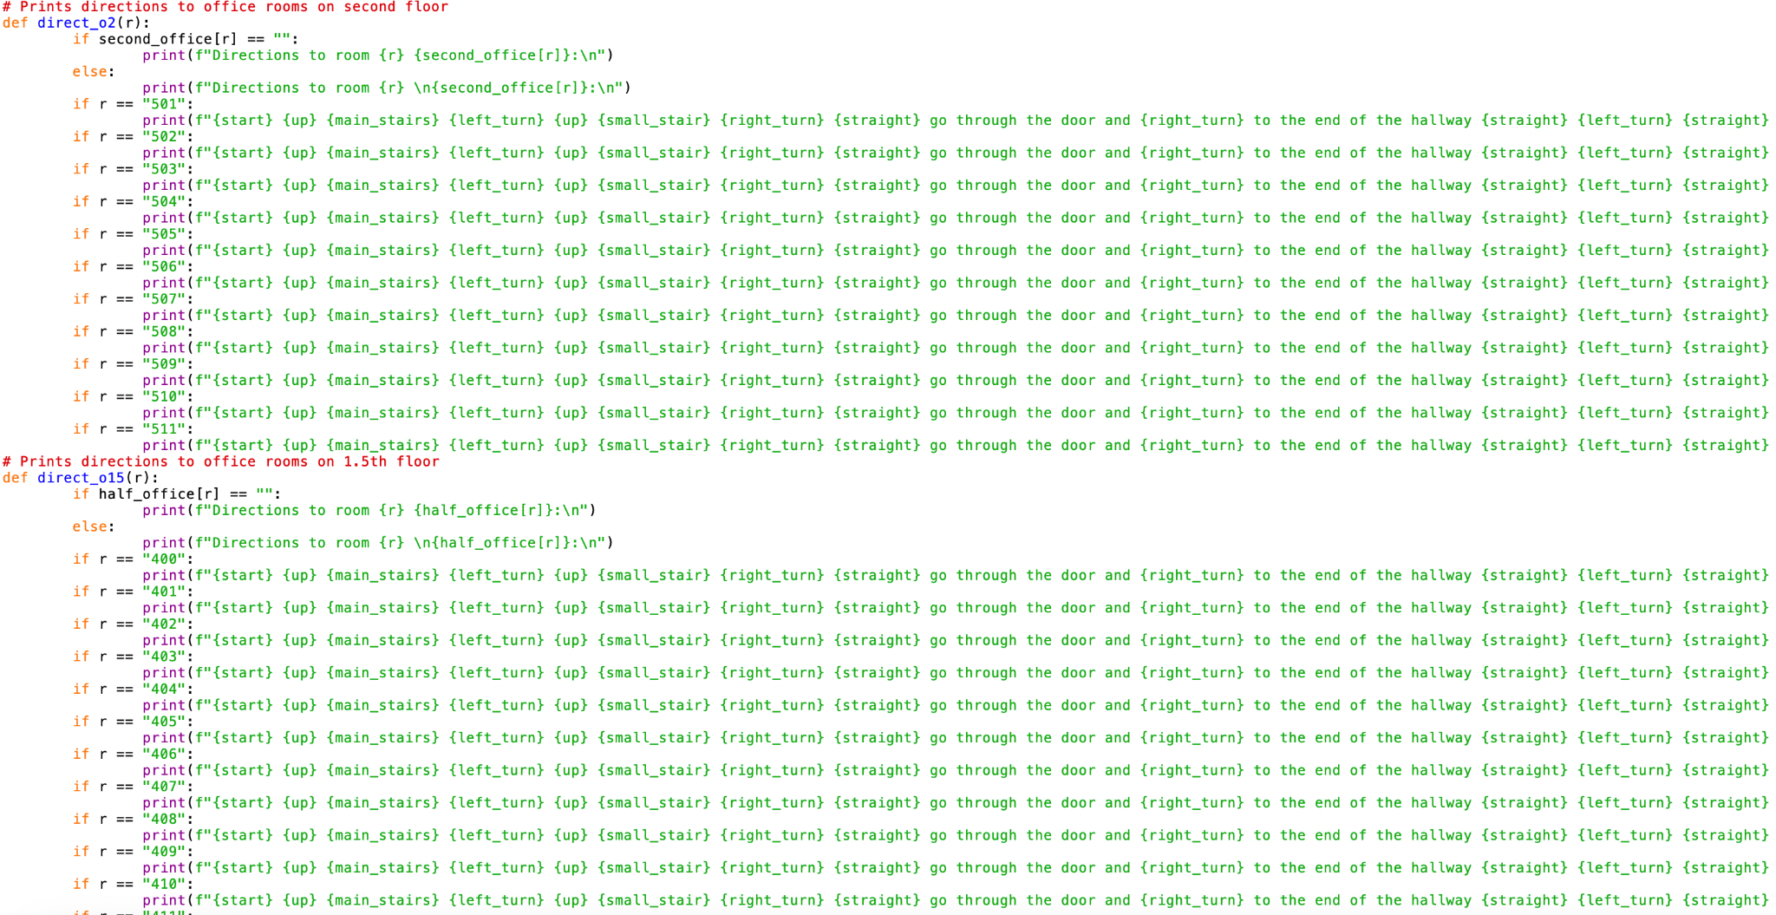

Slide 10
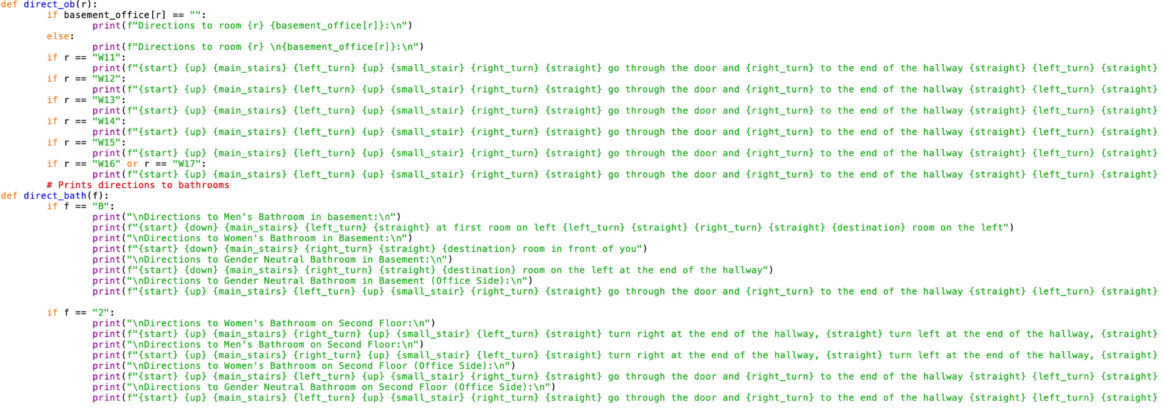

Slide 11
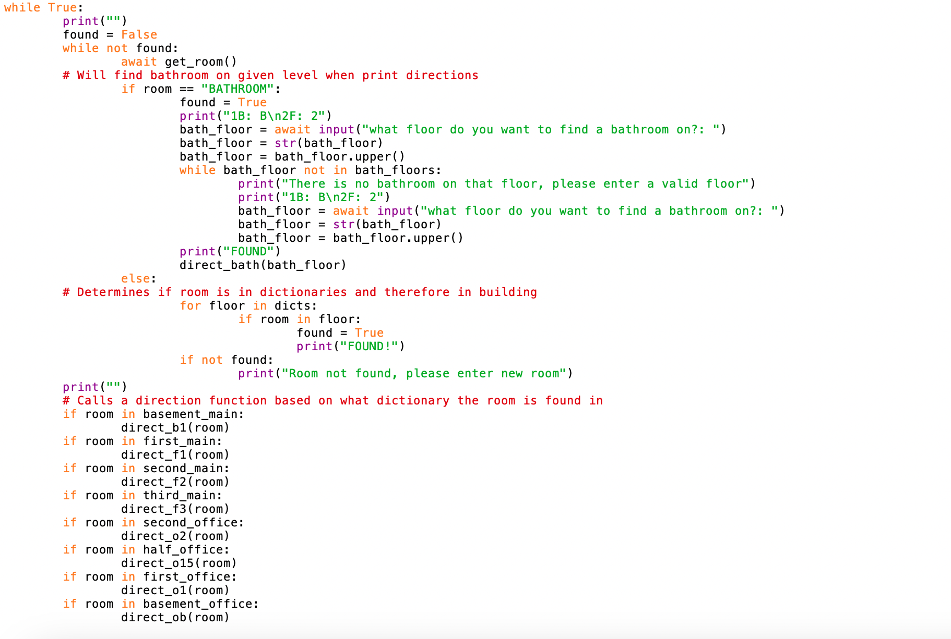

Slide 12
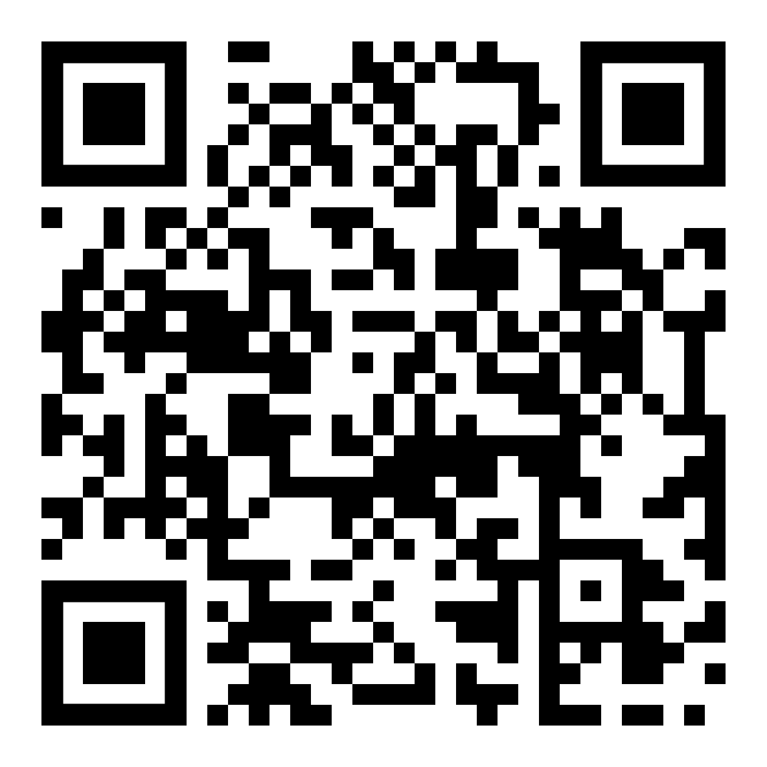
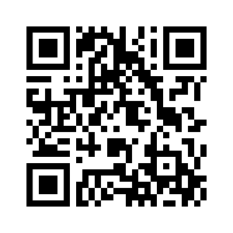
Original
HTML
QR Code for Directory and HTML Version

